Slide 1
Learning Session 1
Brief Overview of Clinic Lab Interface – Continuous Quality Improvement (CLICQ!)

Slide 2

The presence of the Laboratory African Regional Collaboration (LARC) logo on slides
indicates that content (in whole or in part) originates with the LARC Program

Slide 3
Justification for CLICQ!
Implementation in
(*country* red text throughout will be completed by user)

Slide 4
Background
  Global Estimates in 20XX,
  XXM people developed TB
  XXM were notified to national TB programs
  XX% of global TB cases were missed by surveillance systems
  (*country*) Estimates in 20XX
  xxxxx people developed TB
  xxxxx were notified to national programs
  xxxxx were lab confirmed
  xxxxx were initiated on treatment

Slide 5
What is CLICQ!
Clinic-Lab Interface Continuous Quality Improvement

Slide 6
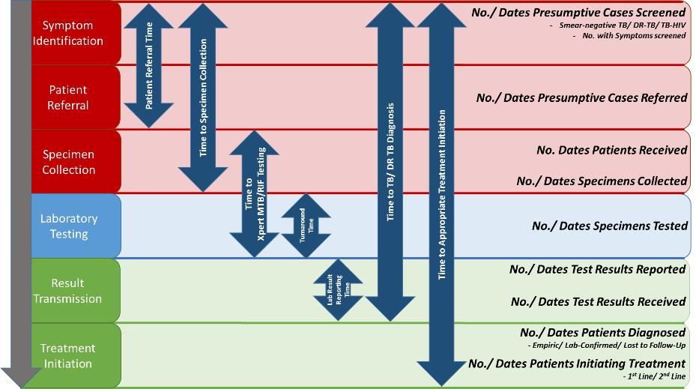
Objectives
Improve HIV & TB patient retention through the TB diagnostic cascade
Increase the number of patients that receive TB lab services, TB diagnosis & TB treatment
Reduce turnaround times between steps in the diagnostic cascade
  Approach
  Bring together HIV and TB programs at the national, subnational and facility levels for improved integrated service delivery
  Build capacity of facility HIV clinic, TB clinic & TB laboratory staff to collectively review data & processes for collaborative CQI
  Measure patient retention across the cascade, or discrete facility-specific gaps, using a new, Excel-based Diagnostic Cascade Evaluation (DiCE) Toolkit
Clinic
Lab
Clinic

Slide 7
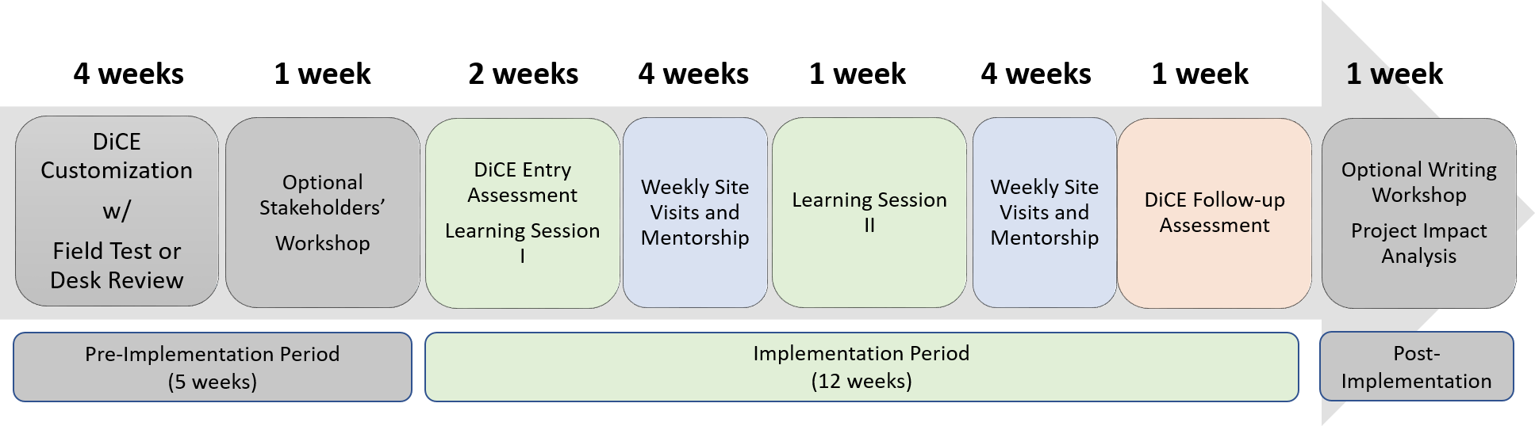
CLICQ!: Designed for Rapid, Targeted Cascade Improvement
NOTE: timeline estimates are only examples and can be modified depending on local context (e.g., program needs, available budget, and available expertise, etc.)

Slide 8
CLICQ!: Designed for Rapid, Targeted Cascade Improvement
Leveraging Successes of SLMTA & LARC
Use a structured, mentorship-based approach using proven tools
Implement only for the time needed to achieve impact (4-6 months)
Build CQI skills capacity through an implementing partner with CQI experience
Form a ‘collaborative’ that maximizes intra- and inter-facility sharing
Map patient pathways at the facility before learning session implementation
Measure program impact on the entire cascade by quantifying all steps before & after implementation (DiCE Toolkit)
Identify resource-saving opportunities for sustainability and potential scale-up

Slide 9
CLICQ! Components
Customizable Data collection toolkit: Diagnostic Cascade Evaluation (DiCE)
Collects aggregate and patient level data from registers at clinics and labs
Quantifies gaps in patient retention and turnaround time within the TB/HIV
diagnostic cascade
Data collected for 3-month intervals
Used for entry and follow-up assessments
2. CQI Program for Patient Retention through the TB Diagnostic Cascade
Conduct two learning sessions and site mentorship visits
Teach CQI methods to clinic and lab staff and apply to patient pathways
Guide clinical and laboratory staff through data collection, use and review
Prioritize gaps and implement site-specific, measurable, improvement projects

Slide 10
(*Country*): State with High TB/HIV Disease Burdens
Site Selection Considerations:
State w/ high disease burden
Sites that service high TB/HIV burden
On-site versus referral TB testing
Geographical and political realities
(*Place map here of country and State*)

Slide 11
DiCE Toolkit:
Diagnostic Cascade Evaluation Toolkit
Concept and Process Overview

Slide 12
DiCE Toolkit Overview
Excel-based toolkit used at the facility level to quantify gaps in the TB treatment cascade
Capable of patient-level and aggregate-level functions
Can be customized to country-specific setting/data sources and features:
  Data Collection tools
  Auto-populated TB cascade analyses
Can be incorporated into routine monitoring and evaluation or continuous quality improvement activities
Necessary time varies depending on site volume, but should take no more than a day once staff are trained and initial walkthrough has been completed

Slide 13
DiCE Assessment Process
Facility walkthrough must occur the first-time facility is assessed with the DiCE Toolkit. Steps include:
    Walk through TB diagnostic cascade at facility
    Identify staff at each step to explain processes
    Identify data sources at each step where key data elements are recorded
After the initial facility walkthrough, less time is needed for the assessment. Steps include:
    Gather data sources for designated period
    Enter data into DiCE toolkit
    Review auto-populated results with site staff

Slide 14
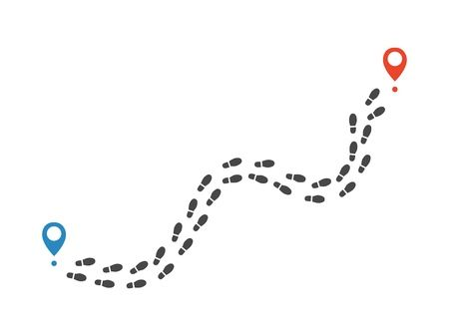
DiCE AsProcess – Initial Walkthrough
4. TB DOTS Clinic
# lab results received, results of lab testing, # started on TB treatment
Ex. data source: TB Treatment Register, Presumptive TB Register
2. Sputum Collection Point
# with specimen collected and sent to lab
Ex. data sources: Presumptive TB Register
1. Patient Entry Point(s)
# patients presented, # screened for TB, # with presumptive TB
Ex. data sources: Presumptive TB Register, TB Screening Register
3. TB laboratory
# specimens received, # specimens tested, results
Ex. data sources: TB Lab Register, Lab Dispatch Register

Slide 15
Additional Considerations for DiCE
DiCE Toolkit includes aggregate and patient-level analyses
  Aggregate: Easiest to obtain data from registers by designating a period and counting totals within the period
    Can demonstrate proportion of patients to complete each step-in cascade, proportion of patients with positive/negative test results; can be made to disaggregate patients by HIV status
  Patient-level: Determine desired sample size and randomly select a sample, then follow these patients through the cascade
    Can demonstrate turnaround time analyses, spot checks for aggregate figures
Toolkit has additional fields for on-site vs referral testing sites as these cascade steps will vary slightly

Slide 16
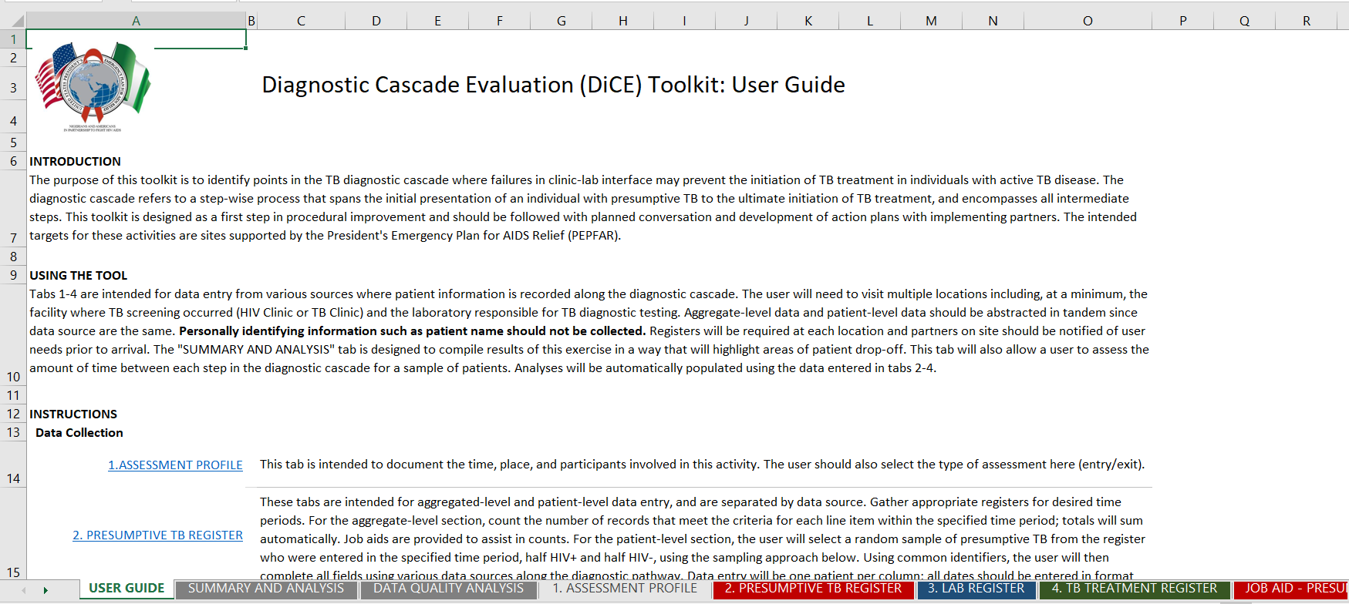
DiCE Toolkit Adaptation and Use
Sample data sources; each will have a job aid
The tool is first customized to fit available data sources.

Slide 17
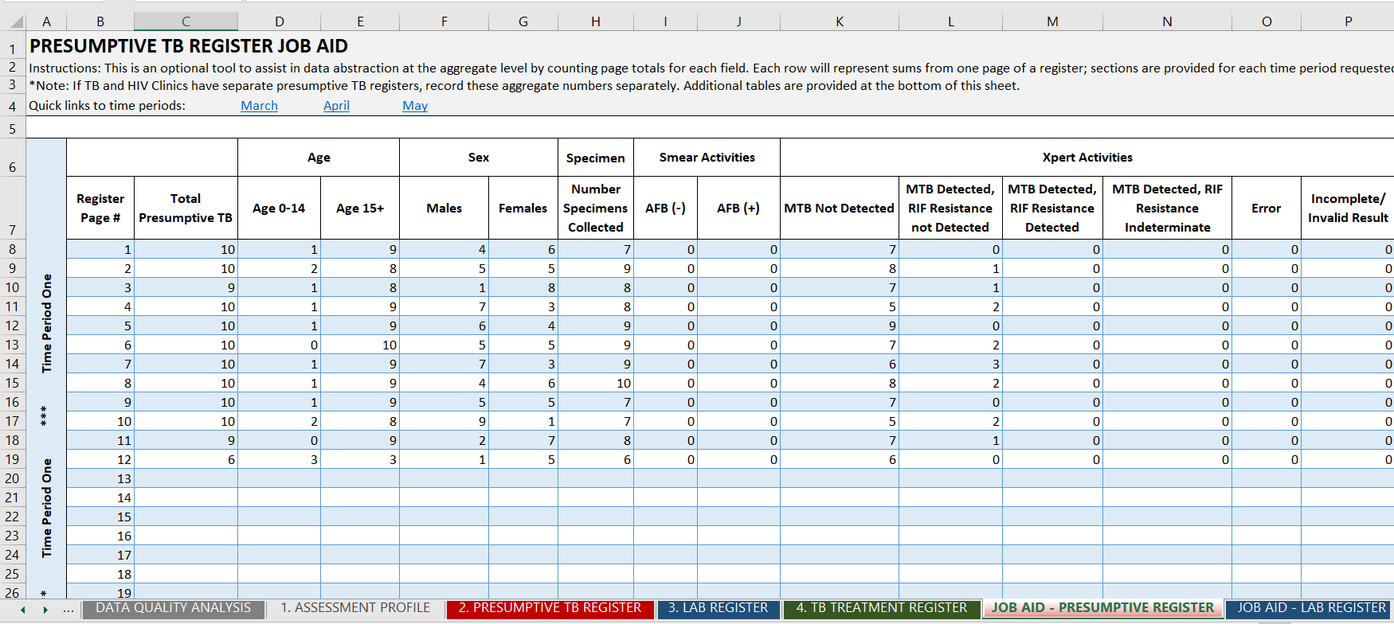
DiCE Toolkit Adaptation and Use
Job aid tabs capture necessary steps of the cascade but can be customized to include specific language/appropriate order of the fields in the available data sources for ease of use.

Slide 18
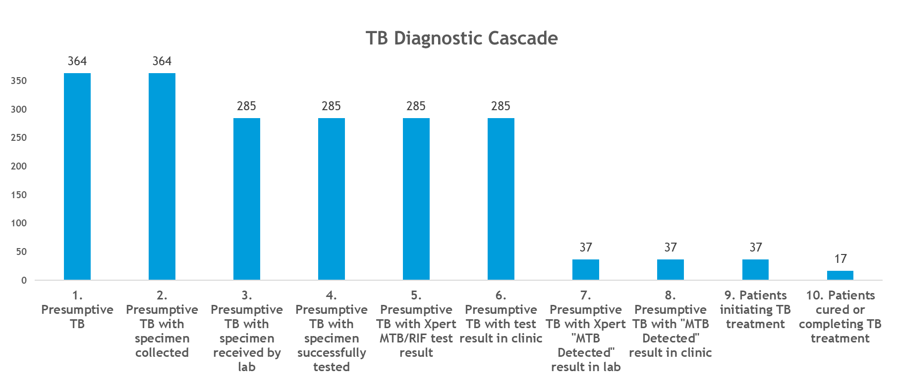
DiCE Toolkit – Example Cascade Analysis
Once the job aids are filled in for a designated period, data from various sources then auto-populates to create a cascade, where gaps can be visualized.

Slide 19
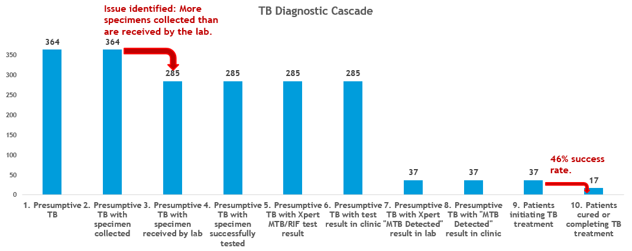
DiCE Toolkit – Example Cascade Analysis

Slide 20
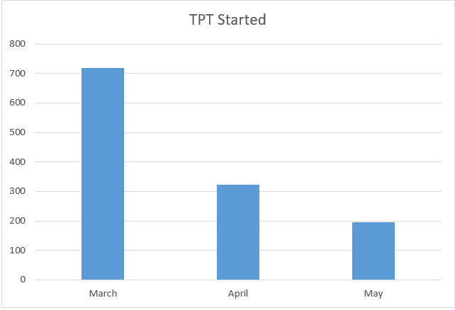
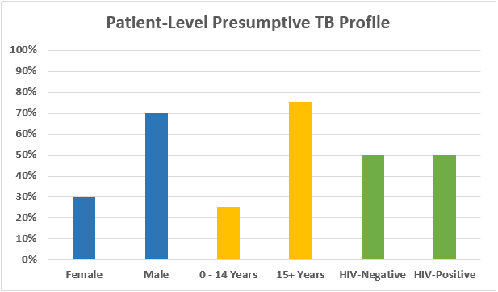
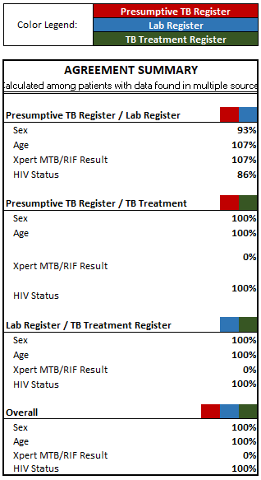
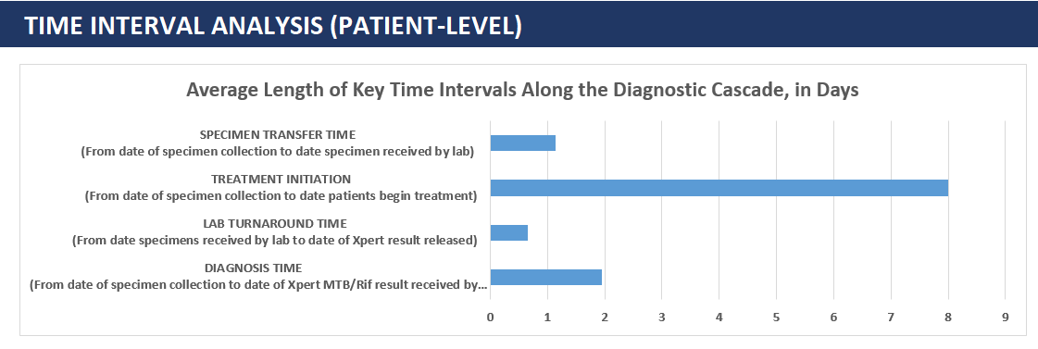
DiCE Toolkit – Additional Outputs
1. 2. 3.
4.

Slide 21
CLICQ! LEARNING SESSIONS AND
IMPROVEMENT PROJECTS
Site Representatives: ART Clinics, M&E, TB DOTS and/ or TB Labs
Observing: (*list partners/organizations*)

Slide 22
What to Expect at Learning Session #1
Participants:
  National and state TB and HIV program staff
  ART clinic, DOTS clinic and lab staff (Doctors, Nurses, HCWs, M&E/ Data, mWRD Focal Persons [e.g., Xpert MTB/RIF Ultra, Truenat MTB Plus], LF-LAM focal persons)
Training and Data Review
  Various didactics on Continuous Quality Improvement (CQI)
  D-M-A-I-C model to improve quality of results
  - Define, Measure, Analyze, Improve, Control
  Process mapping
  - Outline the steps, documents, and focal persons at each step of the cascade of care
  - Collaboratively led by clinic and lab staff
  Review of DiCE Toolkit baseline assessment results
  Gaps/projects sorted into an effort versus impact grid
Identify site-specific improvement projects, define aim statements, objectives and site-specific metrics to monitor weekly site progress
mWRD: molecular WHO-approved rapid diagnostic test

Slide 23
CQI Principles
DM of DMAIC Model: Process Mapping and Selection of Improvement Projects
Process Steps (Examples) | What Happens / Where | Who’s Responsible? | Documents Needed | Opportunities for Improvement
1. Obtain a Hospital Card
2. Patient Identification
3. Escort PT. to DOTs Clinic
4. Necessary documentation & HIV testing
5. Send to TB Lab
6. Sample production & Reception
7. Sample Accessioning
8. Transport Samples
9. GX. Testing at the TB Lab.
10. Document & Dispatch Result to DOTS
11. Document and commence Treatment
Process mapping identifies gaps not captured by data analyses (e.g., DiCE assessments)
LARC Learning Session I PowerPoint

Slide 24
Impact / Effort Grid: A Tool for Prioritizing Opportunities
A tool to rank order potential solutions according to degree of impact and amount of effort
WHY
Allows input from the team, especially those who know the process first-hand, on the potential solutions
Provides an organized process to elicit thoughtful discussion and consensus on the potential impact of a solution and the degree of effort required to create that impact
Allows prioritization of potential solutions
LARC Learning Session I PowerPoint

Slide 25
Impact / Effort Grid
Just Do It
Improvement Projects
(Detailed Planning and Work)
Minor Major
Improvement Improvement
Site 1
IMPACT
Site 2
Site 3
Just Do It if Impactful
Maybe Some Day
Site 4
Site 5
Each dot represents one gap-based activity for each colored site
Easy to Do Difficult to Do
EFFORT
Notes:
Improvement projects developed by CLICQ! participants will be selected from the top-right portion of the grid.
As indicated, these projects will require planning, mentorship, and data tracking.
Examples include:
1. implementing escorts from ART to DOTS
2. changing site of specimen collection to allow direct viewing by a HCW and providing guidance to patient if necessary.
All of the ‘Just Do It’ projects should be completed by the participants.
As indicated, these are ‘Easy Effort with Major Impact.’ These do not require oversight or mentorship.
Participants should ‘just do it.’
Examples include:
1. painting arrows on ground or hanging signs that show patient how to arrive at the next station (e.g., from ART to DOTS)
2. obtain the nationally approved registers to ensure data is collected for the proper indicators
3. hold-documentation training with site level staff

Slide 26
Improvement Projects
DiCE entry assessments will identify gaps in site-specific diagnostic cascade
2. Clinic and laboratory staff will select a gap to target for closure
a. Improvement projects will be developed (including aim statements with objectives)
b. Metrics to track progress toward objectives will be selected
c. Metrics will be monitored weekly to create a run-chart
3. Upon successful closure of selected gap, staff will select another gap and develop another improvement
project and continue closing as many gaps as possible
4. When CLICQ! concludes, a DiCE follow-up assessment will be conducted at all participating sites
5. CLICQ! impact will be determined by comparing the DiCE entry assessment to the DiCE follow-up
assessment as well as the metric run-charts associated with the improvement projects

Slide 27
Examples of ‘Just Do It’ Activity
- Obtain appropriate registers
- Paint arrows on ground to show path from ART to DOTS and Lab
- Improve documentation of presumptive TB clients
- Clear brush from path to DOTS (see pics next slide)

Slide 28
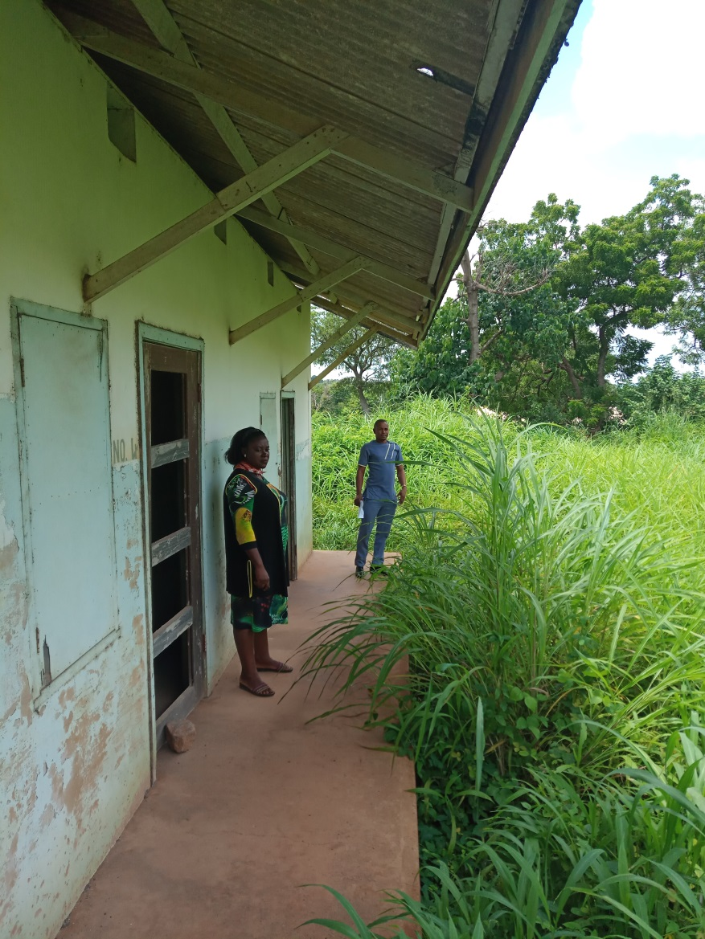
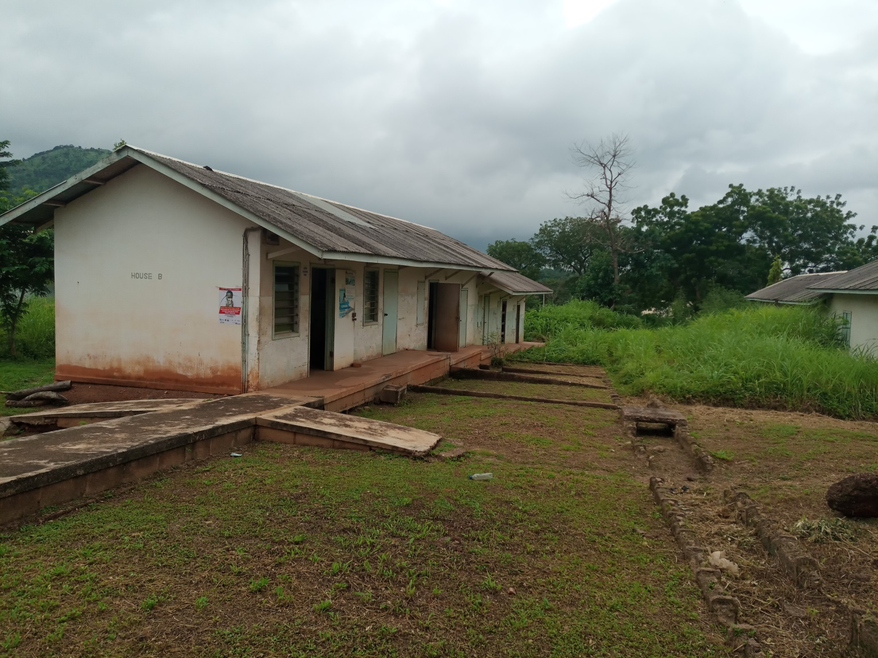
DOTS Clinic before DOTS Clinic after
brush cleared brush cleared

Slide 29
Example Interventions for Improvement Projects
- Switch sputum collection point from lab to DOTS clinic
- Dedicated collection point for easy observation
- Escorts from DOTS to laboratory
- Form a dedicated DOTS office space (see pics next slide)
NOTE: If clinic/lab staff are successful with a primary improvement project, secondary or even tertiary improvement projects should be initiated.

Slide 30
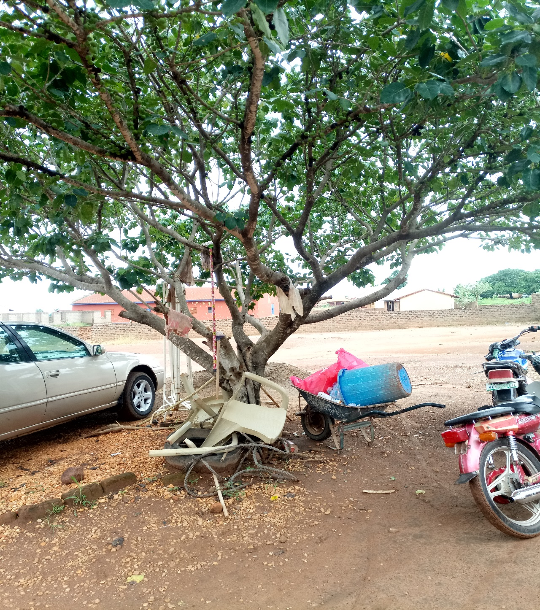
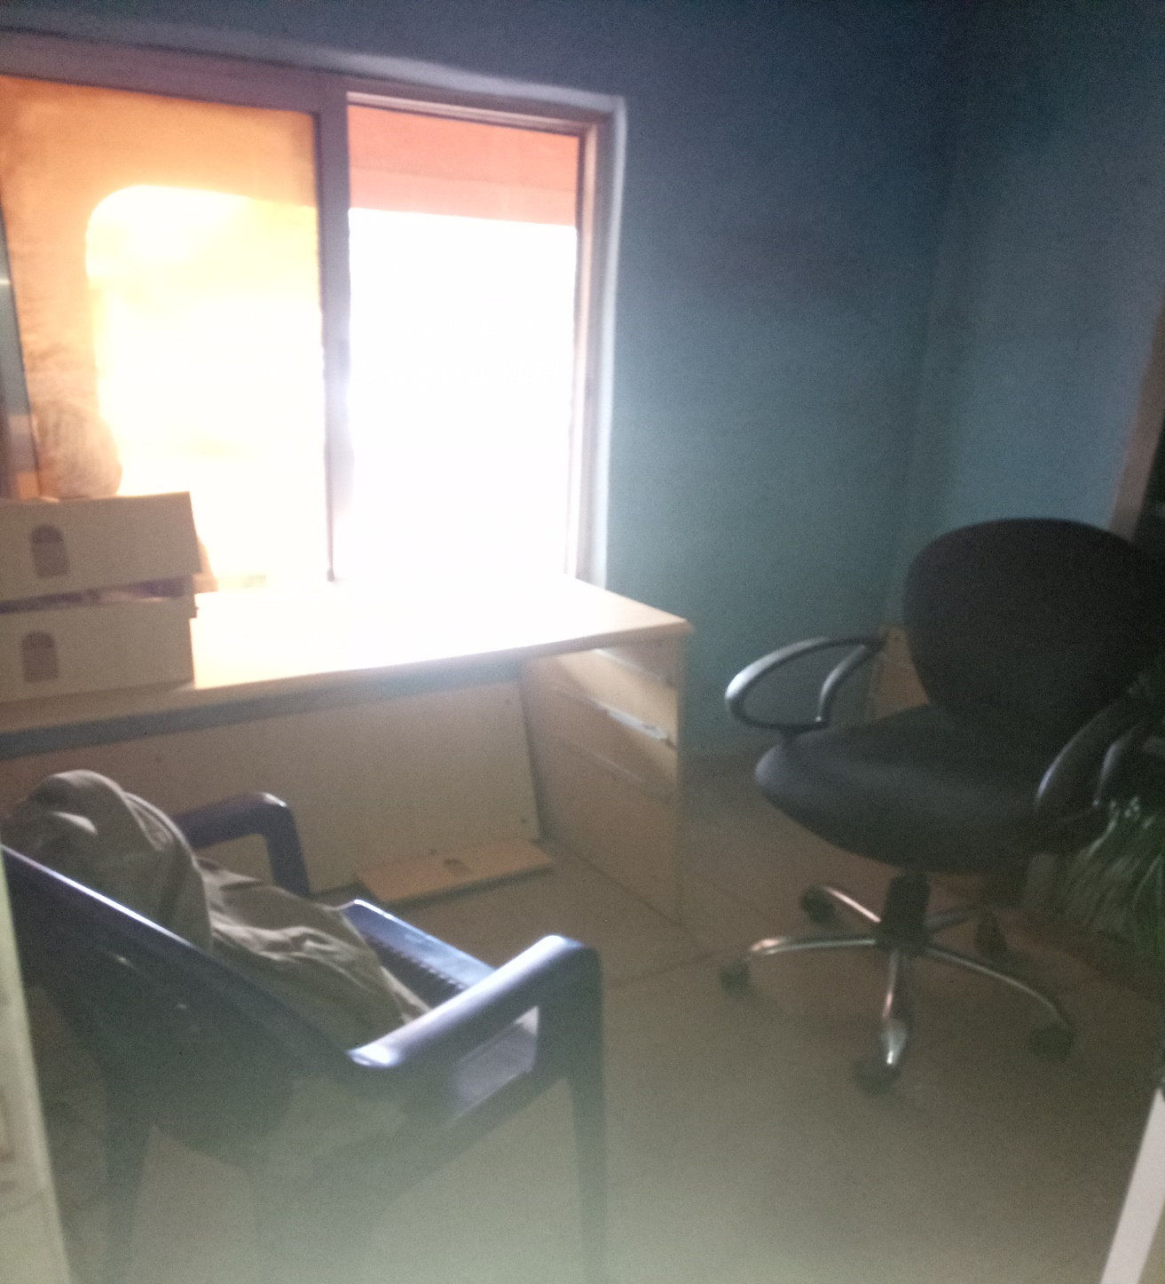
Previous DOTS Clinic Location New DOTS Clinic Location

Slide 31
What to Expect at Learning Session #2
Laboratory and clinic staff presentations
  Primary and secondary ‘Improvement Project’ metrics
  Realtime feedback from enrolled clinics and laboratories on successes and challenges
  Roundtable discussion on ‘next steps’ and sustaining improvement
Additional CQI training
  Didactics: e.g., Space optimization and organization, Waste elimination
  Performance simulations: “TB Clinic walkthrough”
  Receipt of ‘white board’ and creation run-charts to trend progress of improvement projects

Slide 32
Questions?

